Slide 1
Digital Portfolio
STUDENT NAME: MOHAN PRIYA
REGISTER NO :2422K2183
NMID: 37F504F360F969CBFB54199D4F54DB1B
DEPARTMENT: Computer science
COLLEGE: Puratchi Thalaivi Amma GOVT ARTS AND SCIENCE COLLEGE
UNIVERSITY : BHARATHIYAR UNIVERSITY

Slide 2
PROJECT TITLE MOHAN PRIYA PORTFOLIO

Slide 3


AGENDA
Problem Statement
Project Overview
End Users
Tools and Technologies
Portfolio design and Layout
Features and Functionality
Results and Screenshots
Conclusion
Github Link
3/21/2024 Annual Review

Slide 4

PROBLEM STATEMENT Students often struggle to present their academic achievements, skills, and projects in a structured and professional manner. Traditional resumes fail to capture creativity, practical skills, and hands-on experiences, making it difficult for students to stand out in academic or career opportunities. There is a need for a digital portfolio solution that allows students to effectively showcase their competencies, projects, and growth.

Slide 5

PROJECT OVERVIEW By developing this portfolio system, students will have a personalized digital identity that goes beyond a traditional CV, enhancing their chances of securing opportunities in competitive environments. It will also provide academic institutions and recruiters with a reliable and holistic view of a student’s potential

Slide 6

WHO ARE THE END USERS?
Primary End Users: Students
Secondary End Users: Employers, recruiters, faculty, mentors, admission officers

Slide 7

TOOLS AND TECHNIQUES
Tools: trebedit
Techniques: html,css,java script

Slide 8
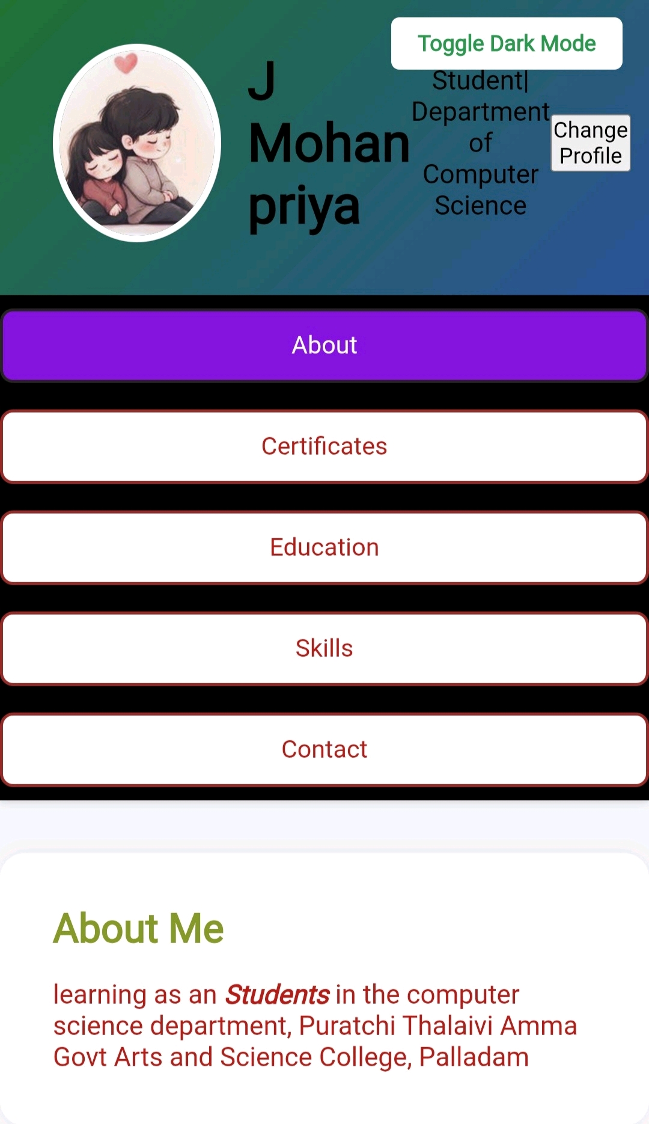
POTFOLIO DESIGN AND LAYOUT
8

Slide 9
FUTURE S AND FUNCTIONALITY
•Homepage: Welcome, brief intro & navigation
•About Me:Studying Details
•Certificate: We developed fundamental
•Education: B.sc Computer science Bharathiyar University
Skills: Tech stack visually represented
•Contact: Form + links to email and social profiles
•toggle mode : toggle mode allows the interface to switch between light mode and dark mode with a single click

Slide 10
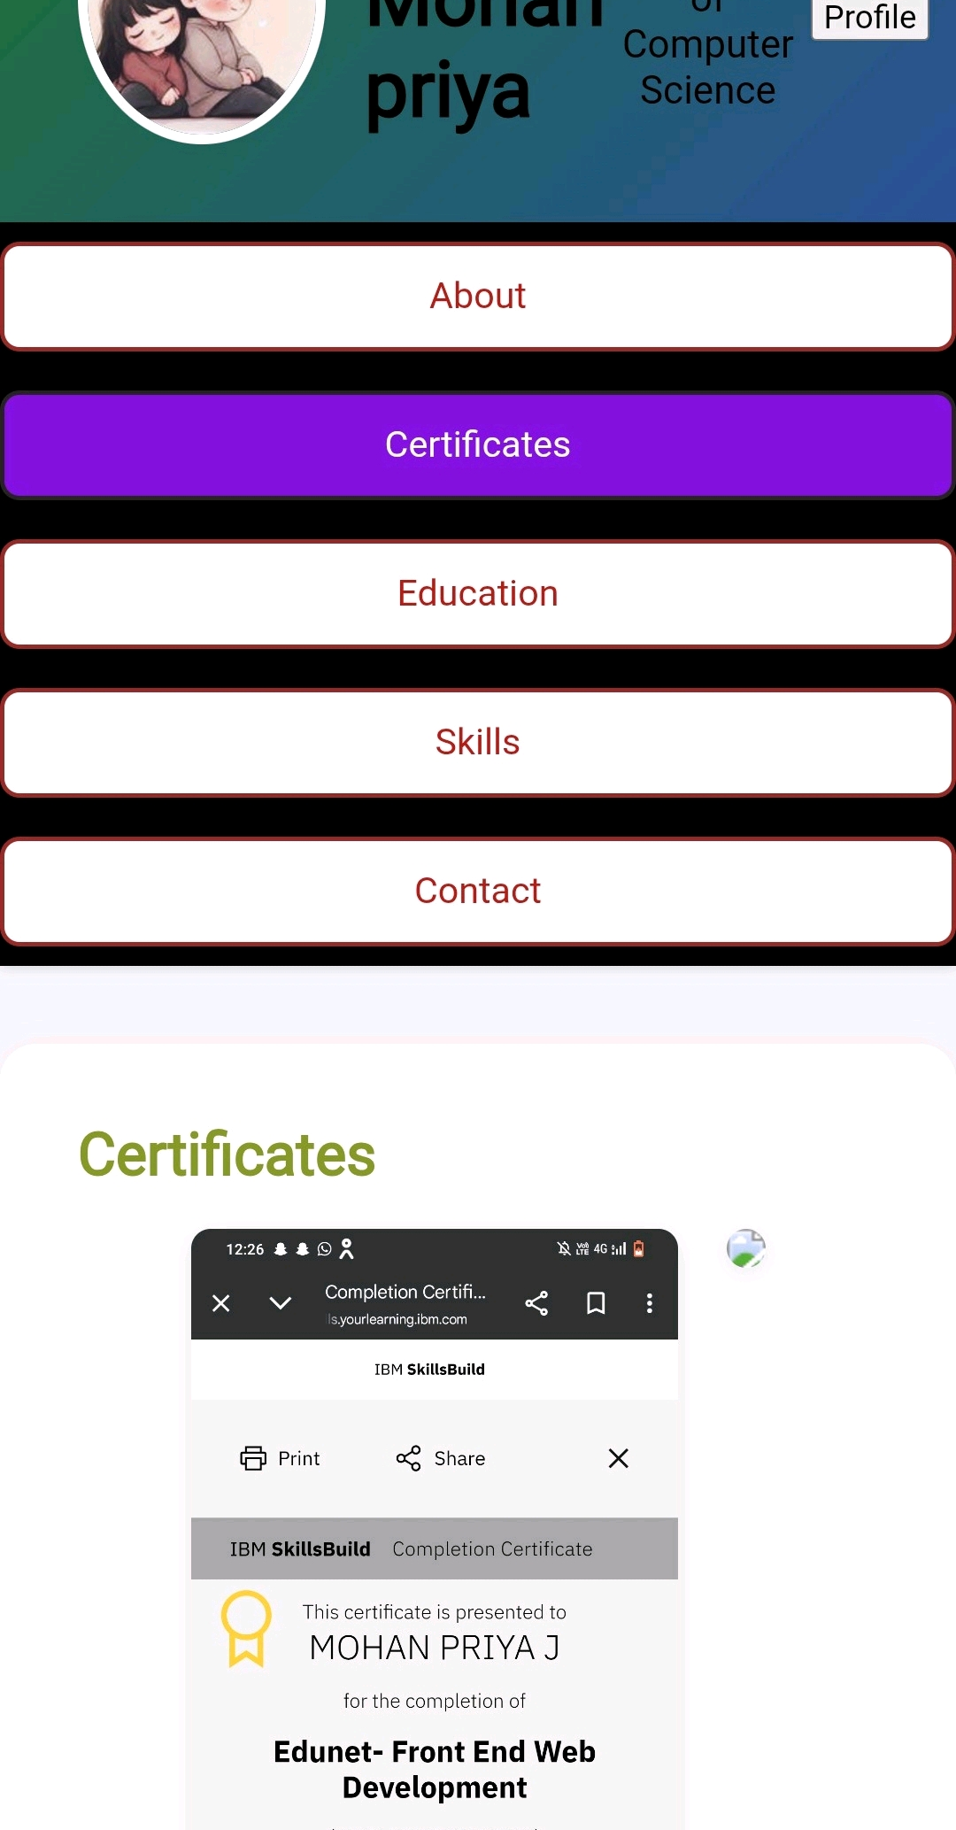

RESULTS AND SCREENSHOTS
3/21/2024 Annual Review
10

Slide 11
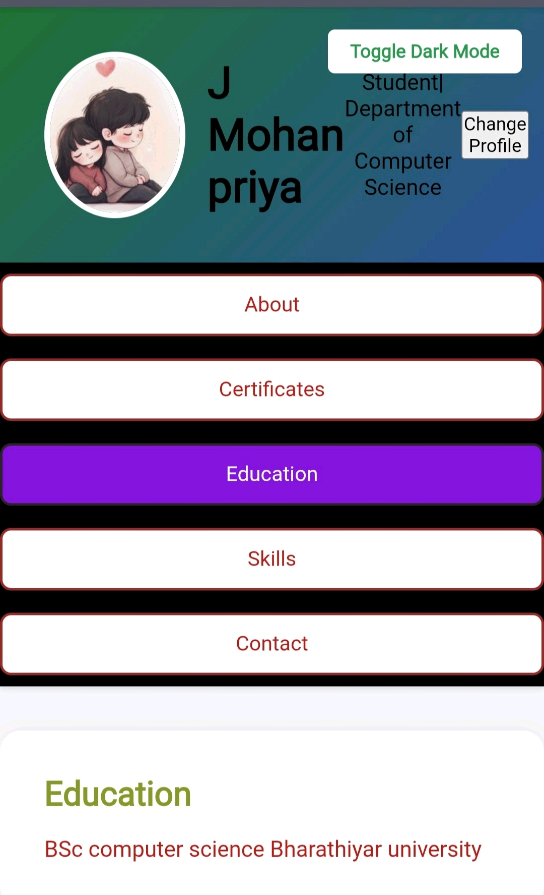
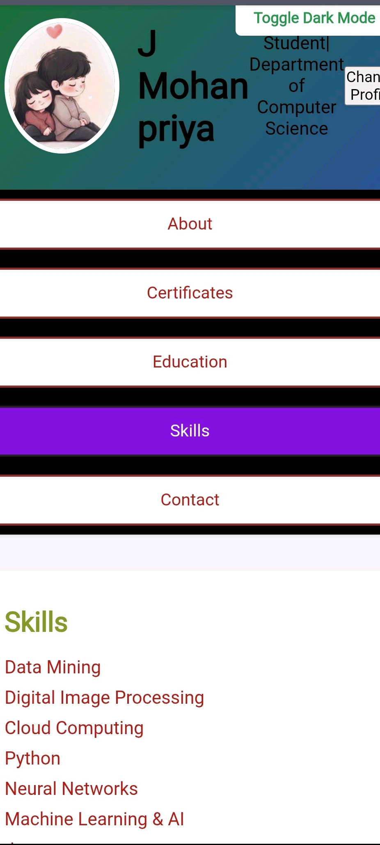
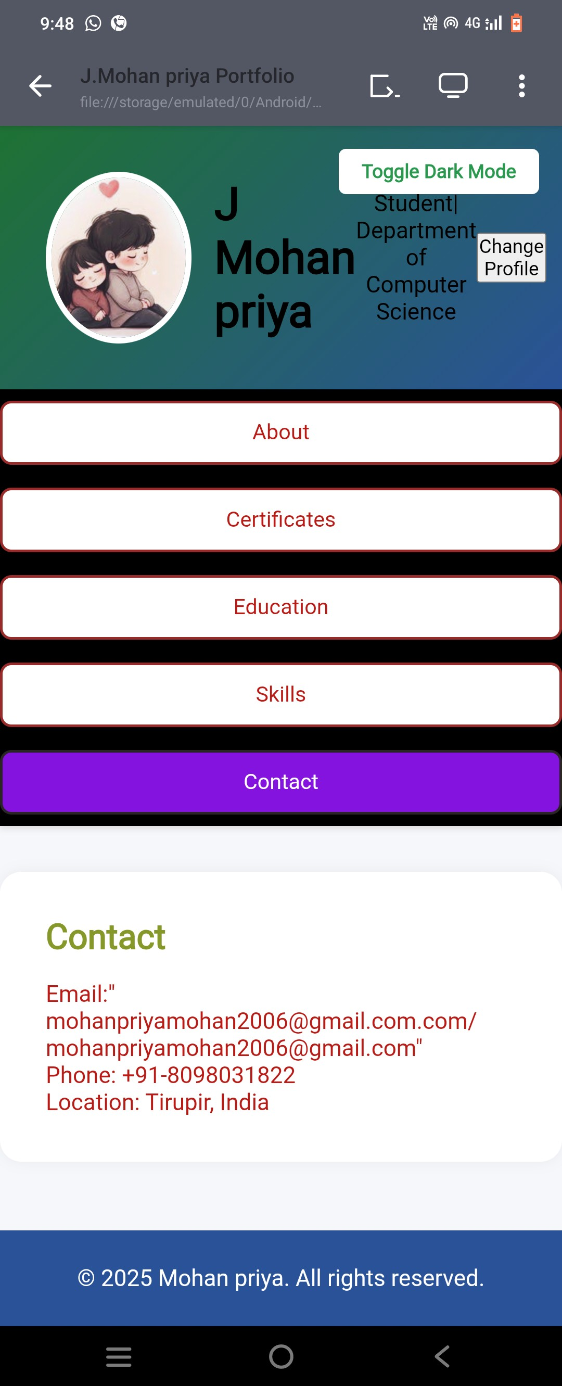

Slide 12
CONCLUSION
The development of the portfolio project successfully achieved its goal of creating a professional, user-friendly, and visually appealing platform to showcase skills, projects, and experiences. The responsive design ensures accessibility across various devices, while the integration of multimedia elements and third-party links enhances the portfolio's effectiveness and reach.
12

Slide 13
Thank you 🙏🏻

